Slide 1



Cancer Cell:
Analyses of rare predisposing
variants of lung cancer in
6,004 whole genomes in Chinese
- www.oebiotech.com -
2022.10.19
郑福兴 / 基因组
Notes:
一篇关于 以6004个中国群体进行的肺癌突变位点研究

Slide 2

Abstract
We present the largest whole-genome sequencing (WGS) study of non-small cell lung cancer (NSCLC) to date among 6,004 individuals of Chinese ancestry, coupled with 23,049 individuals genotyped by SNP array. We construct a high-quality haplotype reference panel for imputation and identify 20 common and low-frequency loci (minor allele frequency [MAF] R 0.5%), including five loci that have never been reported before. For rare loss-of-function (LoF) variants (MAF < 0.5%), we identify BRCA2 and 18 other cancer predisposition genes that affect 5.29% of individuals with NSCLC, and 98.91% (181 of 183) of LoF variants have not been linked previously to NSCLC risk. Promoter variants of BRCA2 also have a substantial effect on NSCLC risk, and their prevalence is comparable with BRCA2 LoF variants. The associations are validated in an independent case-control study including 4,410 individuals and a prospective cohort study including 23,826 individuals. Our findings not only provide a high-quality reference panel for future array-based association studies but depict the whole picture of rare pathogenic variants for NSCLC.
目 录
Notes:
进行了迄今为止最大规模的非小细胞肺癌(NSCLC)全基因组测序(WGS)研究，研究对象包括6,004名中国血统的个体，以及23,049名通过SNP阵列进行基因分型的个体。我们构建了一个高质量的单倍型参考面板，并识别了20个常见和低频位点(次要等位基因频率[MAF] R 0.5%)，其中包括5个以前从未报道过的位点。对于罕见的功能缺失(LoF)变体(MAF < 0.5%)，我们发现BRCA2和18个其他癌症易感性基因影响5.29%的非小细胞肺癌个体，98.91%(183中的181)的LoF变体之前没有与非小细胞肺癌风险联系起来。BRCA2的启动子变体对NSCLC风险也有显著影响，其患病率与BRCA2 LoF变体相当。这些关联在一项包括4,410人的独立病例对照研究和一项包括23,826人的前瞻性队列研究中得到验证。我们的研究结果不仅为未来基于阵列的关联研究提供了高质量的参考面板，而且描绘了NSCLC罕见致病变异的全貌。

Slide 3
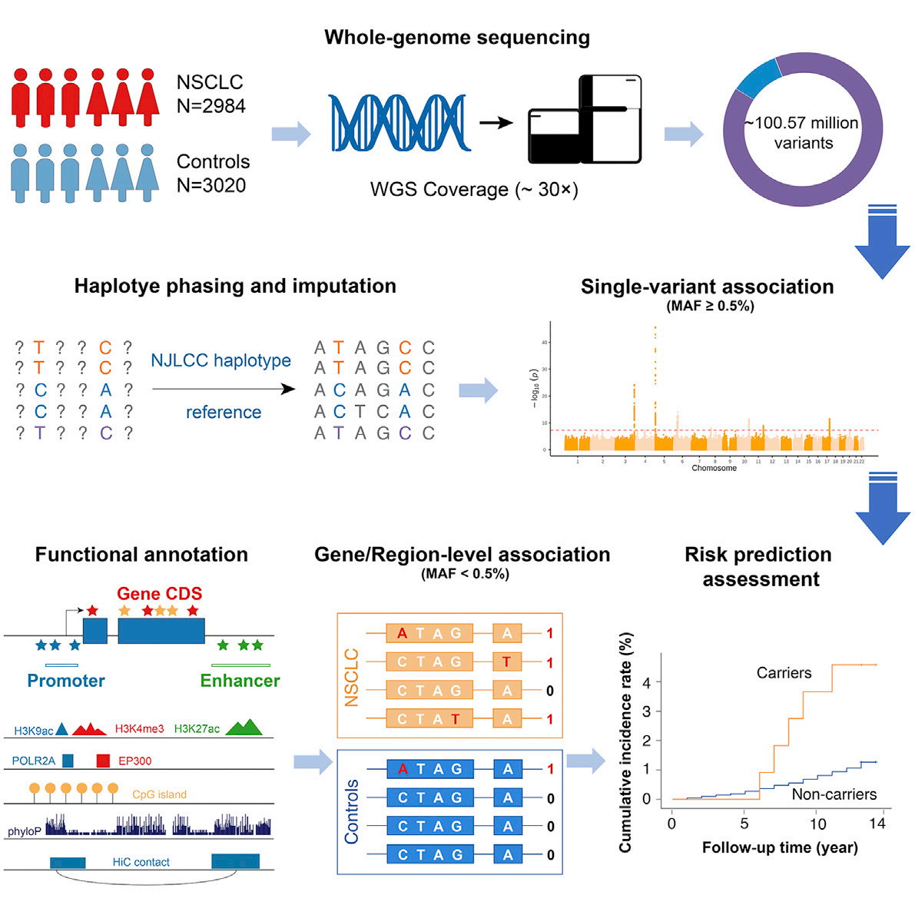
目 录
Notes:
基因组数据的定向和填充（Phasing and Imputation）：定向即分型 将等位基因按照来源进行填充 即按照父母本来源分为两类
填充：对基因型缺失的位点进行填补（Imputation）对这个位点的基因型规律进行总结，然后对缺失位点归到某类中 遗传性缺失：突变造成的缺失； 技术型缺失：测序深度不够导致
gene/region-level association : 基因 区域水平突变关联分析
最后进行风险评估 横轴为跟进年限 纵轴为 累计发病率 黄色为携带突变人群 蓝色为不携带突变的人群

Slide 4
Whole-genome sequencing on 2,984 individuals with non-small cell lung cancer and 3,020 control individuals
Five common and low-frequency loci identified based on high-quality haplotype reference
Rare loss-of-function variants in DNA repair genes increased risk of NSCLC
Rare variants in the promoter of BRCA2 contributed to increased risk of NSCLC
目 录
Notes:
这里是 该文章的 4 个亮点
1. WGS 2984个患者和 3020个对照 群体数量充足
2. 基于高质量参考基因组，找到了 5个常见、低频突变位点
3. 找到了一些稀有的功能丧失突变
4. 发现 promoter 区域产生突变 也会增加患病风险

Slide 5
INTRODUCTION
Lung cancer is the leading type of malignancy with the highest incidence and mortality in China and the world (Bray et al., 2018; Chen et al., 2016). Non-small cell lung cancer (NSCLC) accounts for 85% of total lung cancer cases and presents a severe threat to the health of populations (Molina et al., 2008). Although tobacco smoking is the main risk factor for lung cancer, genetic factors also contribute to development of lung cancer (Malhotra et al., 2016)
In the past two decades, genome-wide association studies (GWASs) have robustly linked 45 genetic loci to NSCLC
however, most of the studies were conducted in the European populations. Our recent work in the Chinese population identifies six additional loci for NSCLC (Dai et al., 2019), suggesting that GWASs in different ancestries may help determine the genetic etiology of NSCLC.
but the analyses are restricted to certain candidate genes rather than on a genome-wide scale.Moreover, the exon regions comprise only a small fraction of the whole genome ( 1%–2%). Regulatory non-coding sequences (e.g., promoters and enhancers), however, are widely distributed across the genome and can alter the transcription and expression of target genes (Andersson and Sandelin, 2020). Whether rare regulatory variants play a pathogenic role in development of lung cancer is still short of study.
目 录
Notes:
背景部分 简化来讲
1. 介绍了肺癌是中国和世界上发病率和死亡率最高的疾病，而非小细胞肺癌在肺癌的分型中又占了85%。吸烟是主要的肺癌发生因素，但是遗传因素也会影响肺癌的发生。（研究基因层面的疾病，一般首先说明遗传力）
2. 介绍了已有的研究成果 45个相关基因与疾病的发生有关。但是所使用到的做gwas的群体是欧洲人种，并且现在主要的参考内容都是基于欧洲人种，例如1000基因组计划（1KG），单倍型参考联盟（HRC）等，而最近研究中以中国人群体作为gwas对象 研究又找到了6个相关基因座 因此使用不同群体对于疾病基因座定位有所区别。
3. 当前NSCLC研究主要是基于已有的候选基因 而不是全基因组水平上的。同时 外显子只占基因组很少一部分。非编码区域占的多，并且会影响基因的表达，但研究的少。

Slide 6
results
We performed WGS (30X) for 3,043 individuals with NSCLC and 3,084 cancer-free control individuals recruited from the NJLCC. All raw data were uniformly processed, and joint variant calling was performed by a standardized Burrows-Wheeler Aligner (BWA)-Genome Analysis Toolkit (GATK) pipeline (McKenna et al., 2010). After stringent quality control at the sample level, we included a total of 2,984 affected and 3,020 control individuals for further analyses (Figure 1A; Table S1)
目 录
Principal-component analysis showed that all participants were Han Chinese, and the ancestry was highly matched (Figure 1B). Further variant quality control determined 100,565,590 short variants (Figure S1A), including 91,942,266 (91.43%) single-nucleotide variants (SNVs) and 8,623,324 (8.57%) small insertions or deletions (indels) of 50 bp or less (Figure 1C). In the present study, only 8,079,426 (8.79%) SNVs and 1,082,986 (12.56%) indels were considered common and low-frequency (MAF ≥ 0.5%), of which 99.64% have been recorded in the gnomAD database. The vast majority of variants were rare (MAF < 0.5%; 91.21% SNVs and 87.44% indels), and 77.30% of these rare variants were singletons or doubletons (Figure 1C). Unlike the common and low-frequency variants, 68.59% (62,694,229/91,403,178) of the rare variants (i.e., singletons, doubletons, and other variants with MAF < 0.5%) we found were absent from the gnomAD database (Figure 1D）
Notes:
我们对从NJLCC招募的3043名非小细胞肺癌患者和3084名无癌对照者进行了WGS (30X)检查。对所有原始数据进行统一处理，并通过标准化的Burrows-Wheeler Aligner (BWA)-Genome Analysis Toolkit (GATK)管道执行联合变量调用(McKenna等，2010)。在样本水平经过严格的质量控制后，我们共纳入2,984例受影响个体和3,020例对照个体进行进一步分析(图1A;表S1)
主成分分析显示所有参与者都是汉族人，且祖先高度匹配(图1B)。进一步的变异质量控制确定了100,565,590个短变异(图S1A)，包括91,942,266个(91.43%)单核苷酸变异(SNVs)和8,623,324个(8.57%)小于或小于50 bp的小插入或删除(indels)(图1C)。在本研究中，只有8079426个(8.79%)snv和1082986个(12.56%)索引被认为是常见和低频(MAF≥0.5%)，其中99.64%在gnomAD数据库中被记录。绝大多数变异是罕见的(MAF < 0.5%;91.21%的SNVs和87.44%的invs)，其中77.30%的罕见变异为单子或双子(图1C)。与常见和低频变体不同，我们发现的68.59%(62,694,229/91,403,178)的罕见变体(即单子、双子和MAF < 0.5%的其他变体)从gnomAD数据库中缺失(图1D)。

Slide 7
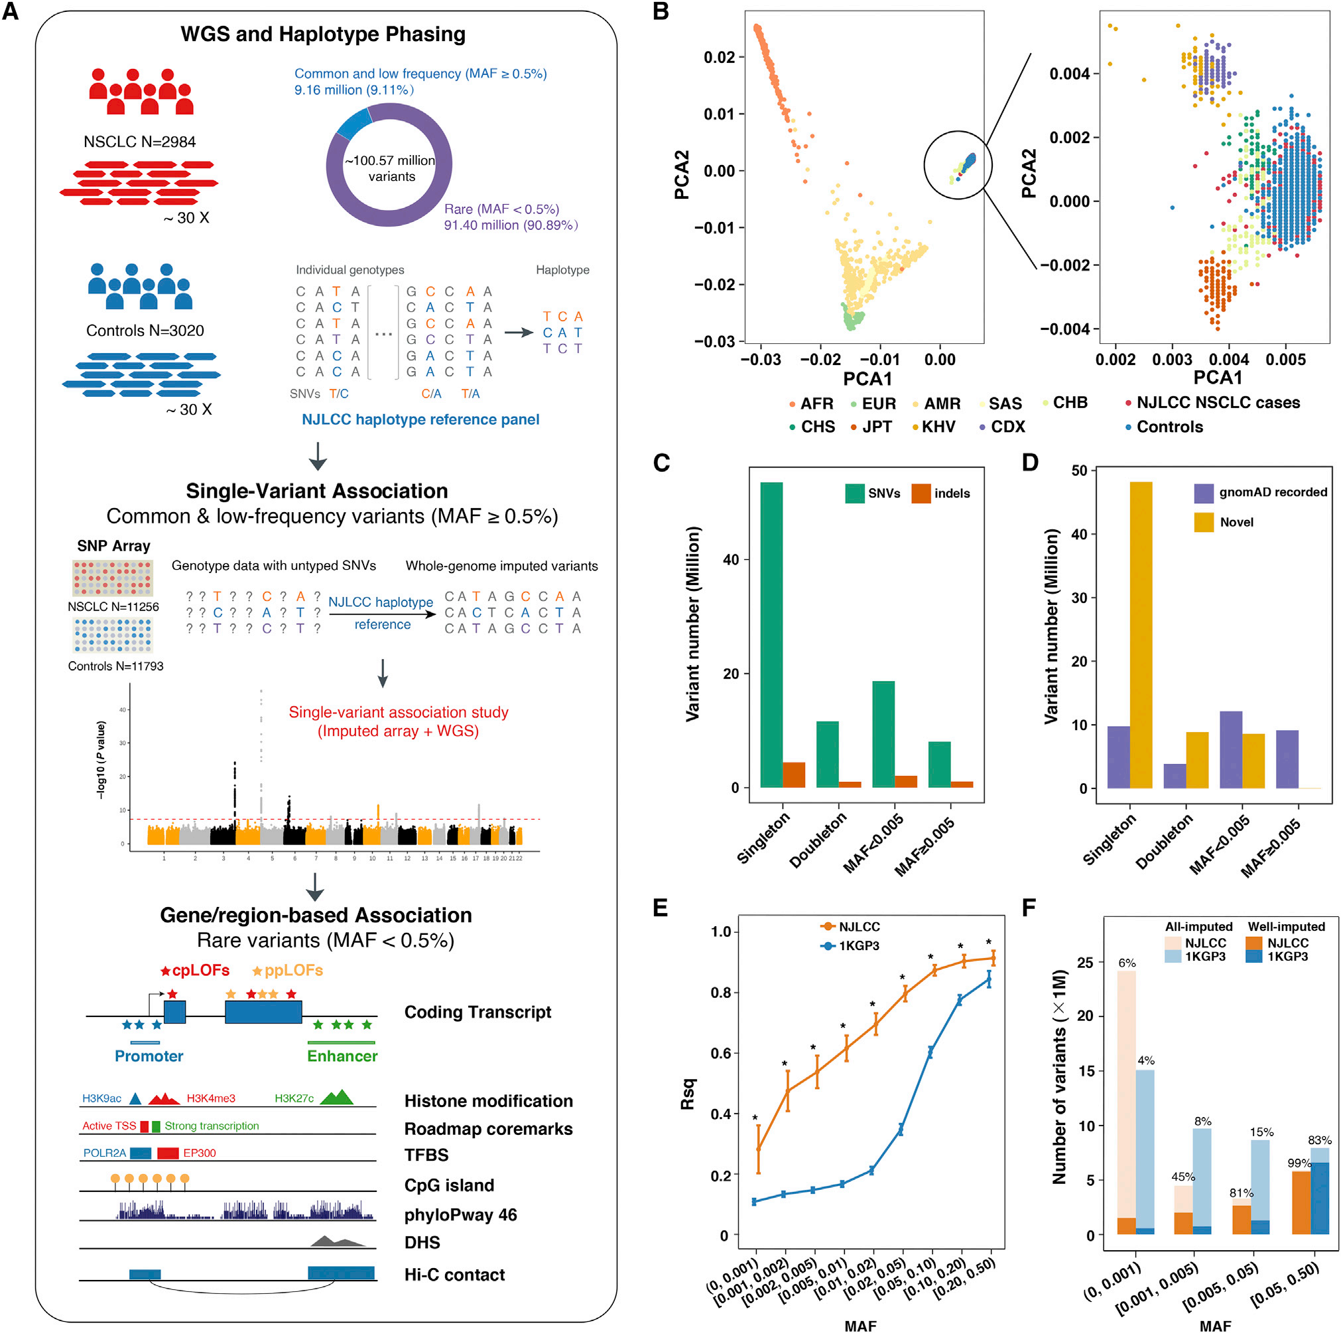
目 录
Notes:
fig A：DHS:DNA酶高敏感位点
phylopway 46:基于46个哺乳动物物种的多序列比对得到位点的保守性分值，分值越大，位点越保守。该分值考虑的是变异位点的保守性，而非考虑该位点上的碱基，所以无论该位点上是同义突变还是非同义突变，score都相同。该分值用来寻找具有功能重要性的位点，利用这些score值，能够推断出疾病易感性位点
fig B:PAC图像，根据血统聚类 两个图实际上是一个 将圈中放大得到第二张图片
AFR 非洲人；AMR 混血美国人；CDX 西双版纳地区中国傣族人；CHB 中国北京汉人；CHS 中国南方汉人；KHV 越南人；JPT 日本人；EAS 东亚人；EUR 欧洲人
fig C：MAF：最小等位基因频率
singleton ： 个体中出现了一个突变，并且该基因是杂合子（杂合子基因其中一个发生突变）
doubleton：个体中出现了一个突变，并且该基因是纯合子（纯合子其中一个基因发生了突变）
fig D：统计各种突变在数据库中出现的次数 和 novel 数量
fig E：横轴为最小等位基因频率 纵轴为决定系数 Rsq：R-square 决定系数 这里作者想要说明 做的比 1KG 第三阶段更好
fig F：基于两个不同的基因组做出的结果，横轴同上 纵轴为 call 到的变异数量 图例为估算和实测的比例 均高于 1KG P3

Slide 8
we first constructed the NJLCC haplotype reference panel by using the WGS data from 3,020 unrelated cancer-free control individuals and then imputed our previously published array-based GWAS (Dai et al., 2019), including 11,256 individuals with NSCLC and 11,793 control individuals accordingly (Figure 1A).
目 录
The NJLCC reference panel was constructed with 6,040 Chinese haplotypes, including 34,543,265 SNVs and 3,847,182 indels.
To evaluate the imputation performance of the reference panel, we calculated the estimated R-squared (Rsq) correlation for each imputed variant and found that the NJLCC reference panel outperformed the 1KGP Phase 3 (1KGP3) (Genomes Project et al., 2015) reference across all MAF bins, where the median Rsq was higher among NJLCC-imputed data (p < 0.01) (Figure 1E).
Notes:
我们首先使用3020个不相关的无癌对照个体的WGS数据构建NJLCC单倍型参考面板，然后将我们之前发表的基于阵列的GWAS (Dai等人，2019)，包括11,256名NSCLC个体和11,793名对照个体(图1A)。
NJLCC参考面板由6040个中国单倍型组成，其中snv 34,543,265个，inddel3,847182个。
为了评估参考面板的imputation性能，我们计算了每个imputation变体的估计r -平方(Rsq)相关性，发现NJLCC参考面板在所有MAF箱中优于1KGP Phase 3 (1KGP3) (Genomes Project et al.， 2015)参考，其中中值Rsq在NJLCC imputation数据中更高(p < 0.01)(图1E)。

Slide 9
Because the majority of the rare variants (MAF < 0.5%) identi-fied in WGS were singletons or doubletons that can hardly be imputed (Figure 1C), we applied a burden test in 2,984 affected individuals and 3,020 control individuals with WGS data for the association analysis by aggregating rare variants based on coding sequence (CDS) or regulatory regions (i.e., promoters and enhancers). All 91,403,178 rare variants were included in the analysis. To better evaluate the functions of these variants, we first defined 33,619 lung-expressed coding transcripts of 16,278 protein-coding genes based on mRNA expression data of 427 normal lung tissues from the Genotype-Tissue Expression (GTEx) portal and 116 NSCLC tumor and adjacent normal pairs from the NJLCC (Figure 1A) and then performed transcript expression-aware annotation and functional prioritization. For variants located in the CDS and flanking 2-bp regions, we applied a protocol by adopting and extending the American College of Medical Genetics and Genomics (ACMG)-Association for Molecular Pathology (AMP) guidelines to determine pathogenicity; we identified 65,234 LoF variants, including 1,905 ClinVar-defined pathogenic (P) or likely pathogenic (LP) LoF variants (cpLoFs) and 63,329 putative P LoF variants (ppLoFs) (Figure 1A). For promoter regions of lung-expressed coding transcripts that were defined according to transcription start sites of the Functional Annotation of the Mammalian Genome (FANTOM) database (Consortium et al., 2014), we generated a combined score to prioritize variants that may affect promoter activity (235,026 variants; Figure 1A). For lung-active enhancer regions defined by integrating DNase-seq and chromatin immunoprecipitation sequencing (ChIP-seq) data of H3K27 acetylation (H3K27ac) from normal lung tissues and the A549 cell line, we re-analyzed high-throughput chromosome conformation capture (Hi-C) data of the A549 cell line, which resulted in 18,081 enhancers with targetable genes (539,093 variants) (Figure 1A).
目 录
Notes:
由于在WGS中鉴定的大多数罕见变异(MAF < 0.5%)是难以推断的单基因或双基因(图1C)，我们使用WGS数据对2984个受影响个体和3020个对照个体进行负担检验，通过基于编码序列(CDS)或调控区域(即启动子和增强子)聚集罕见变异进行关联分析。所有91,403,178个稀有变种都被纳入分析。为了更好地评估这些变异的功能，我们首先基于来自基因型-组织表达(GTEx)门的427个正常肺组织和来自NJLCC的116个NSCLC肿瘤及相邻正常对的mRNA表达数据，定义了16278个蛋白编码基因的33,619个肺表达编码转录本(图1A)，然后进行转录本表达感知注释和功能优先级排序。对于位于CDS和侧翼2-bp区域的变异，我们采用并扩展了
美国医学遗传学和基因组学学院(ACMG)-分子病理学协会(AMP)指南
来确定致病性;我们鉴定了65234个LoF变体，包括1905个clinvar定义的致病性(P)或可能致病性(LP) LoF变体(cpLoFs)和63329个假定的P LoF变体(ppLoFs)(图1A)。对于根据哺乳动物基因组功能注释(FANTOM)数据库的转录起始位点定义的肺表达编码转录本的启动子区域(Consortium et al.， 2014)，我们生成了一个综合评分，以优先考虑可能影响启动子活性的变体(235,026个变体;图1 a)。对于整合正常肺组织和A549细胞系中H3K27乙酰化(H3K27ac)的dna -seq和染色质免疫沉淀法测序(ChIP-seq)数据定义的肺活性增强子区域，我们重新分析了A549细胞系的高通量染色体构象捕获(Hi-C)数据，结果有18081个增强子具有靶向基因(539,093个变异)(图1A)。
burden test：基因负荷检验 负荷检验假定基因或者特定区域内的所有低频变异与某一性状存在因果关联，并且方向相同，效应大小一致（调整权重后）

Slide 10
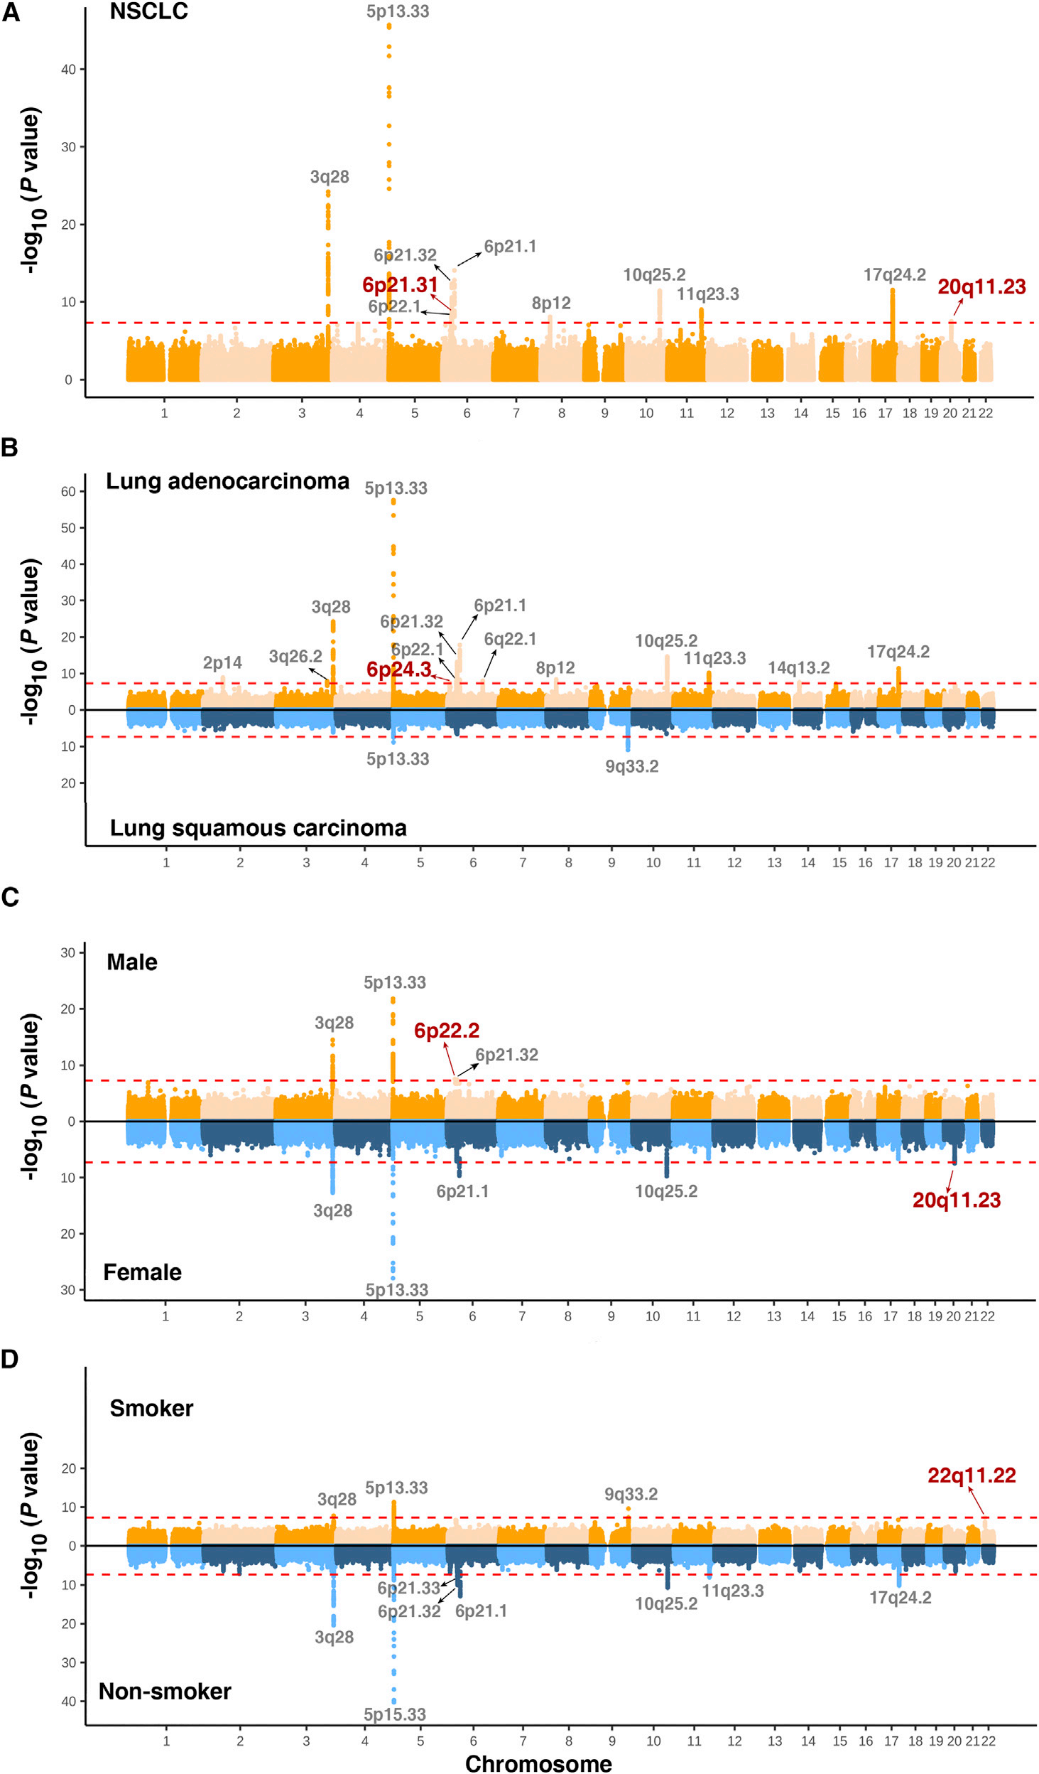
目 录
Notes:
为了确定该病的风险位点，作者将 WGS 数据 以及公共的 芯片数据整合起来进行gwas 分析
该图是一张gwas的曼哈顿图
A 所有患者一起做的分析
B 按照性别做分析
C 按照肺癌分型做分析（鳞癌，腺癌）
D 按照是否吸烟进行分析
p 短臂 q 长臂 染色体号 短臂/长臂 区号 带号 亚带号 次亚带号
红色的编号为 此前研究未报到的位点
共5个位点未被报道

Slide 11
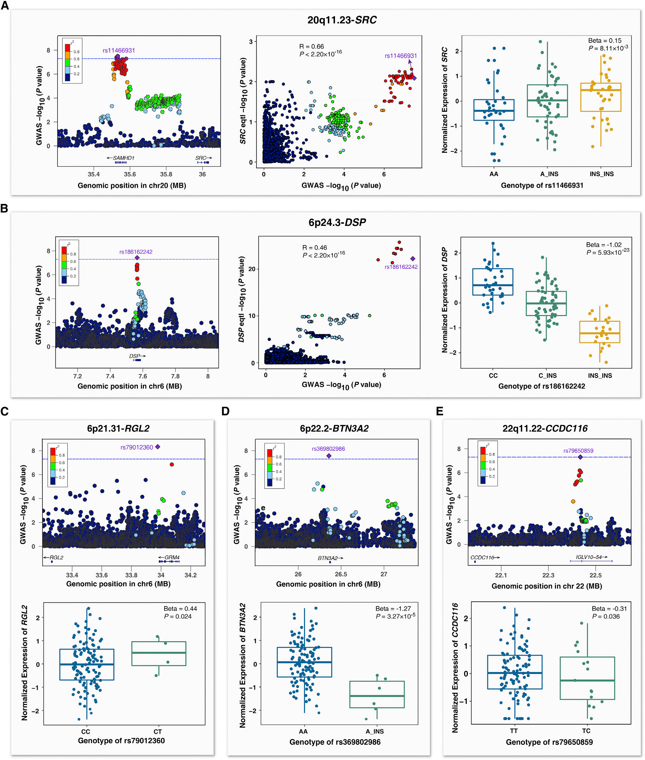
目 录
Notes:
为了确定此前未被报道的NSCLC位点的功能相关基因，我们利用来自中国血统NSCLC患者的116个癌旁组织的基因型和转录组数据，构建了肺组织特异性表达定量性状位点(eQTL)数据库
对 5个 基因进行位点水平的 GWAS-eQTL 共定位分析

Slide 12
目 录
Notes:
3个低频变异体 也有比较显著的 eQTL 信号 考虑到多重比较 BTN3A2 与他的 变体 表现出了比较强的相关性

Slide 13
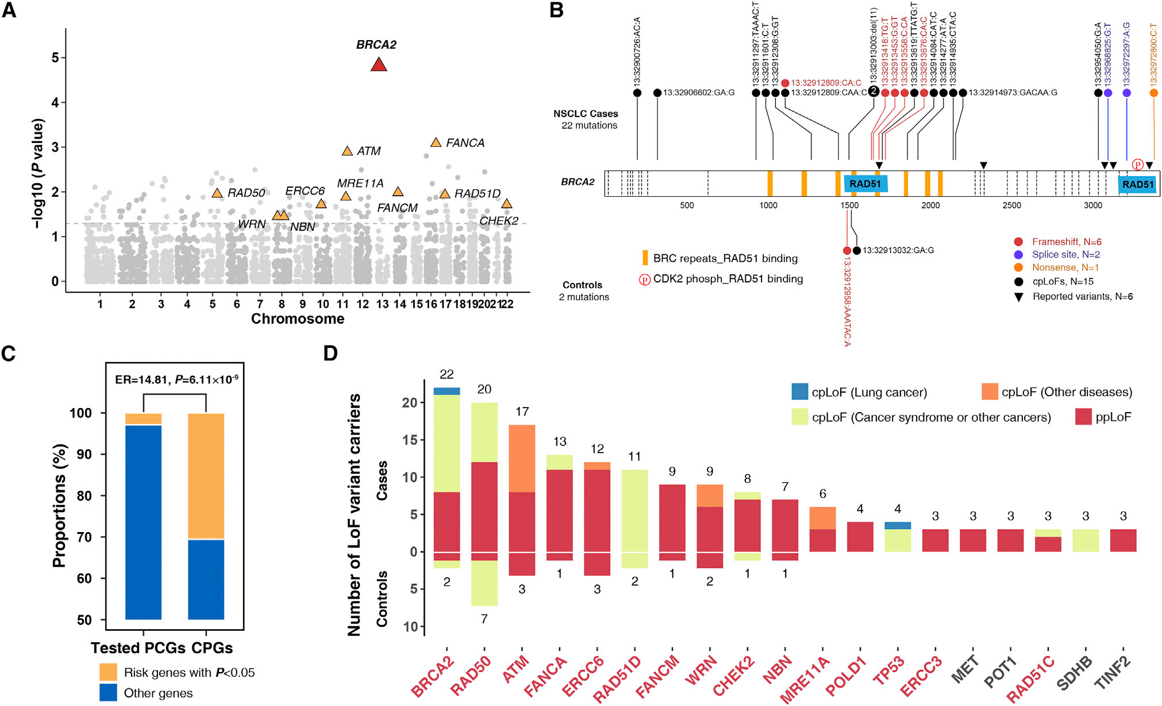
目 录
Notes:
FIG A 基因水平的gwas分析；曼哈顿图，横轴chromosome 纵轴显著性取 -log10 ；作者使用了 3268个至少有3个LoF变异的基因 进行CDSs中罕见变异(MAF < 0.5%)的基因基础分析 BRCA2是最高信号，在FDR方法多次测试校正后，其风险相关性仍然显著
FIG B 在BRCA2 的转录本中 可发生22此 lof 突变 不同颜色代表不同突变类型
FIG C 风险突变 在 CPG 癌症易感基因中 富集
FIG D 上方为患者携带的突变 下方为对照的突变 患者携带的突变更多 纵轴突变书 横轴为基因名

Slide 14
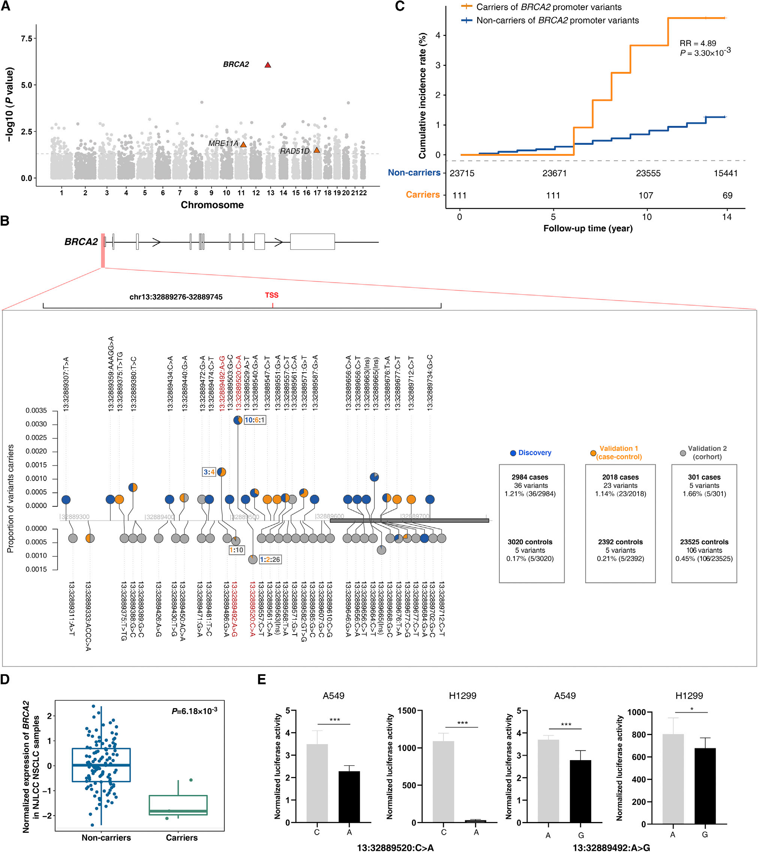
目 录
Notes:
A 基于启动子 增强子 再次进行 关联分析（区域水平关联分析） 使用了 10041个 至少发生三次变异的区域 结果显示 BRCA2 经过多重假设后 依然达到显著水平 使用另一个公共数据验证后 得到了一致的结果
C 随访年限 启动子突变 与 发病率的关系 下方数字代表随访人数
？？？问题（为何该曼哈顿图 没有出现 点被托上去的情况）

Slide 15
目 录
Notes:
BRCA2 TSS 区域变体 示意图 Y 轴代表了 每种变体携带者的比例
蓝色代表实验集 黄色为验证集1 灰色为验证集 2

Slide 16
目 录
Notes:
D 突变后表达量显著下调
E 突变后 启动子活性也明显降低 （荧光素酶法）

Slide 17
In summary, we show that a WGS-based study not only provides a high-quality reference that greatly improves the efficiency of array-based genetic studies to identify additional common and low-frequency susceptibility variants but also helps depict the whole picture of rare pathogenic variants. These findings greatly broaden our understanding of the genetic etiology of lung cancer and will ultimately improve precise prevention of lung cancer.
目 录
Notes:
总之，我们的研究表明，基于wgs的研究不仅提供了一个高质量的参考，极大地提高了基于阵列的遗传研究的效率，以识别额外的常见和低频易感变异，而且还有助于揭示罕见致病变异的全貌。这些发现极大地拓宽了我们对肺癌遗传病因学的认识，并将最终提高肺癌的精确预防

Slide 18


THANKS FOR LISTENING
感谢聆听
© oebiotech.2022 | 上海欧易生物医学科技有限公司

